Slide 1

Speculative Ancestry with
Toni Morrison, Alice Walker, and Joseph Bruchac
MELUS 2026 – Beyond the Page
Storytelling and Speculation in Black Women’s Fiction panel
Rachel Northrop – rachelnorthrop.com

Slide 2
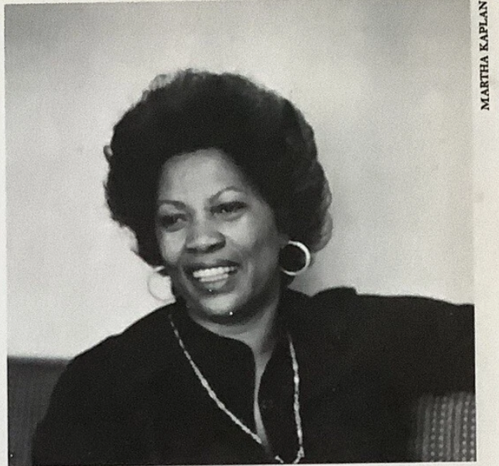
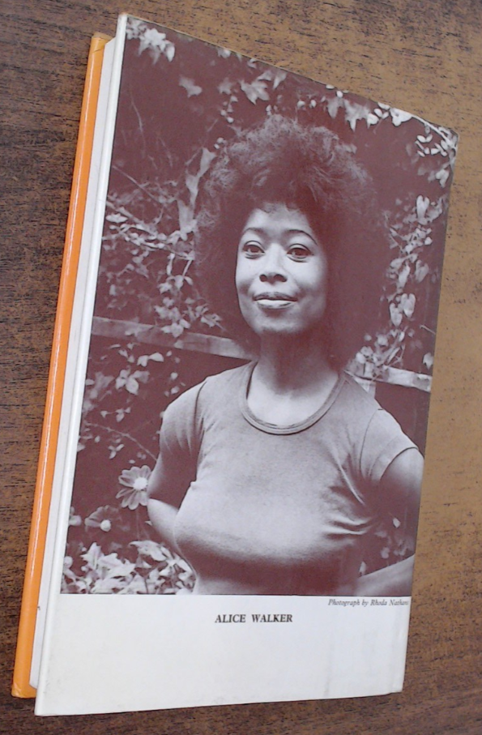
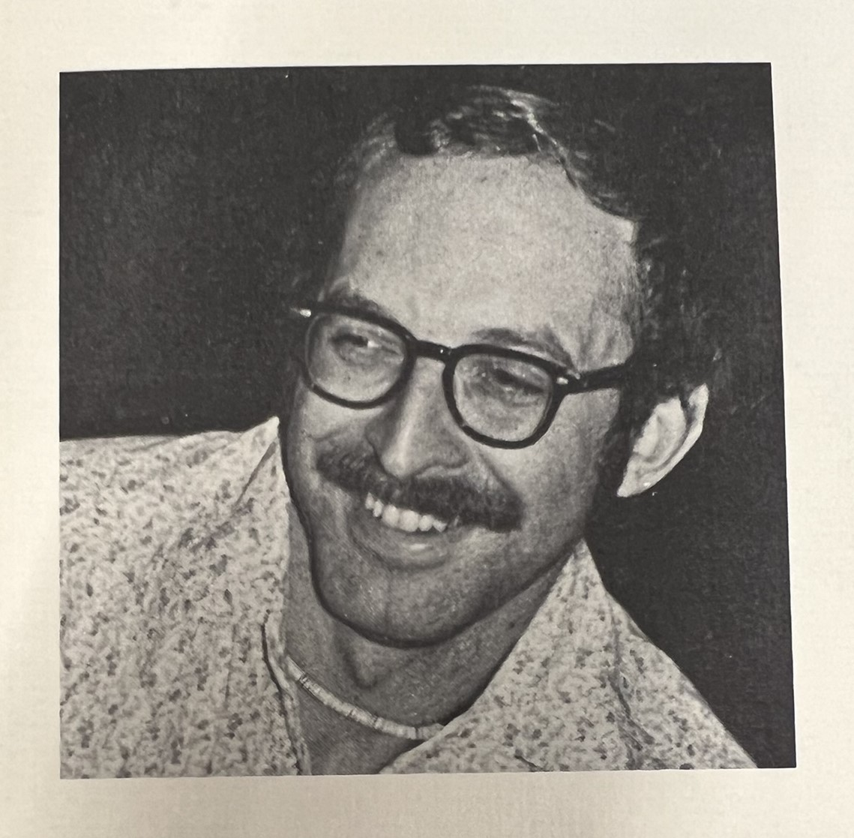
Toni Morrison
Joseph Bruchac
Alice Walker

Slide 3
“Metaliterary commentary” = an author’s interviews and essays about their literary writing (method, motivation, goals, influences, considerations and concerns)

Slide 4
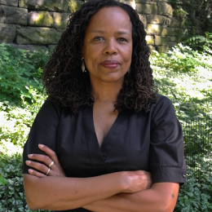
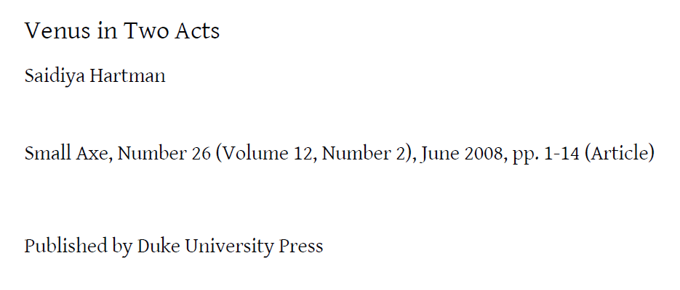
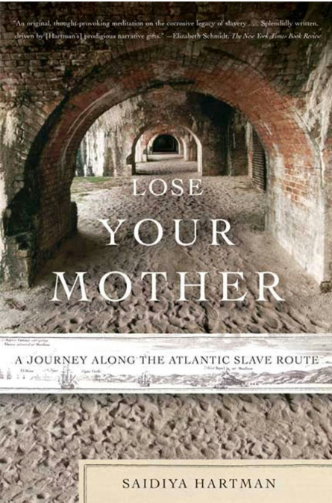
“critical fabulation”
theory defined in article in practice in book
“strains against the limits of the archive […] to imagine what might have happened or might have been said or might have been done”
Farrar, Straus and
Giroux, 2008

Slide 5
“speculative ancestry”
Like Hartman does historically, Morrison, Walker, and Bruchac apply the speculative questions “what if” and “what might have been?” to frame their literary explorations of the past.

Slide 6
Toni Morrison
b. 1931
Lorain, OH
Joseph Bruchac
b. 1941
Greenfield Center, NY
Alice Walker
b. 1944
Eatonton, GA

Slide 7
What does it mean to have ancestors who have been lost?
What do we do with ancestors who have gotten lost?
How might fiction and poetry be ways to figure out who they might have been?
How might it be possible (or not) to know them?

Slide 8
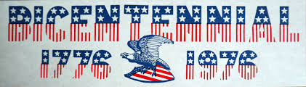
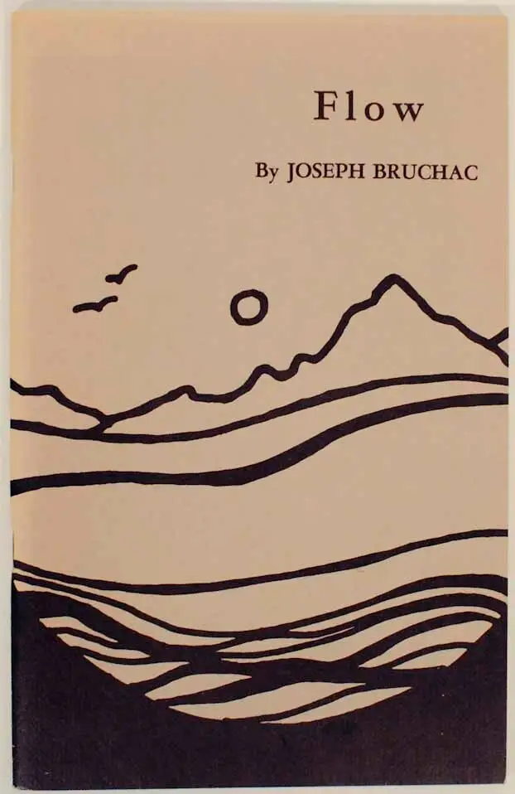
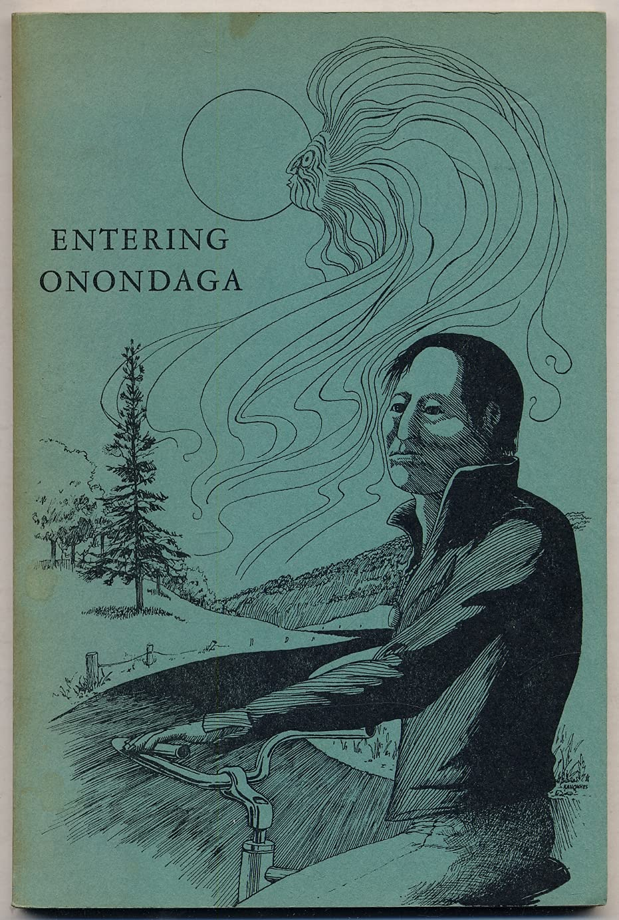
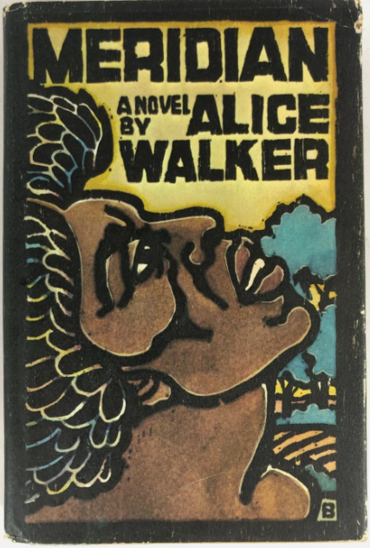
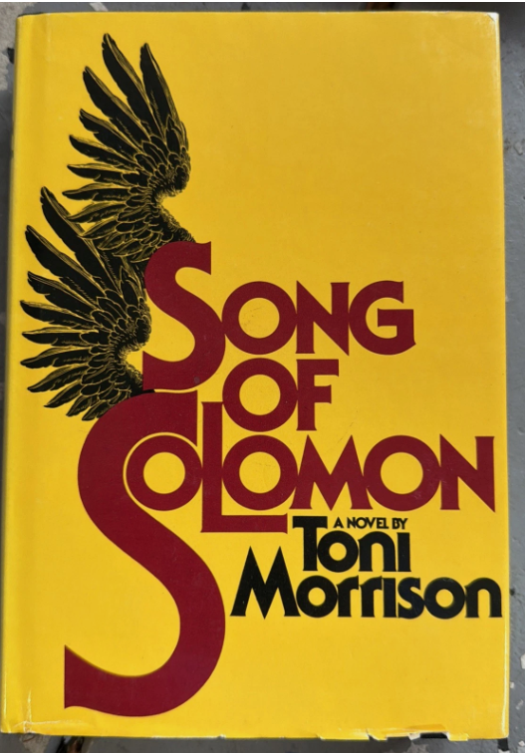
1975 1976 1977 1978

Slide 9
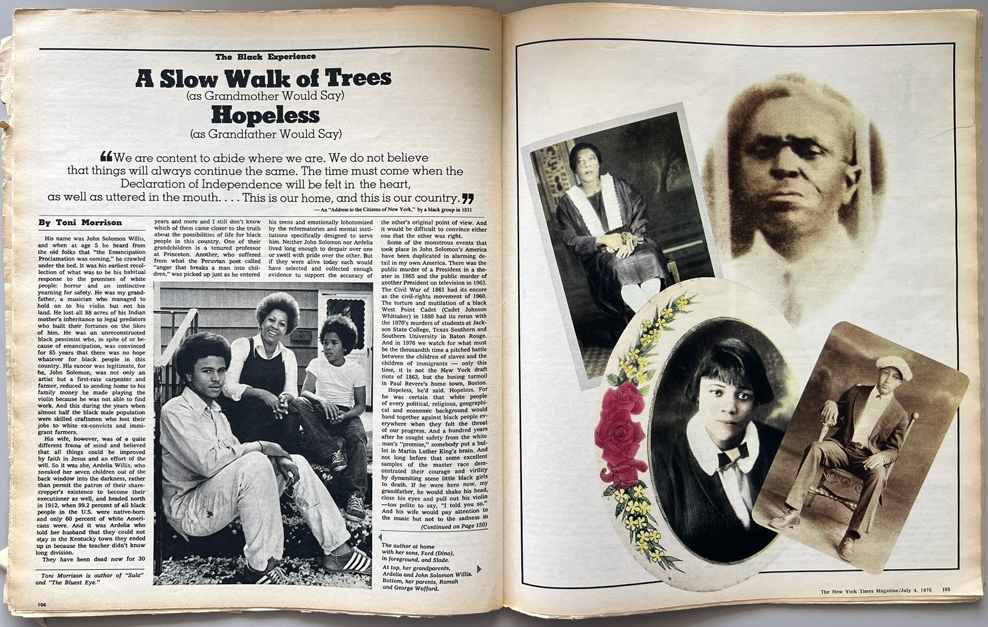
“lost all 88 acres of his Indian mother’s inheritance to legal predators.”

Slide 10
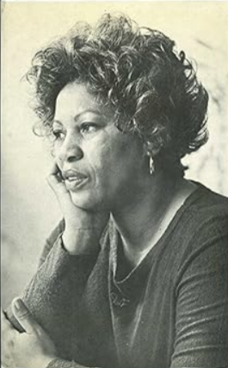
1977

Slide 11
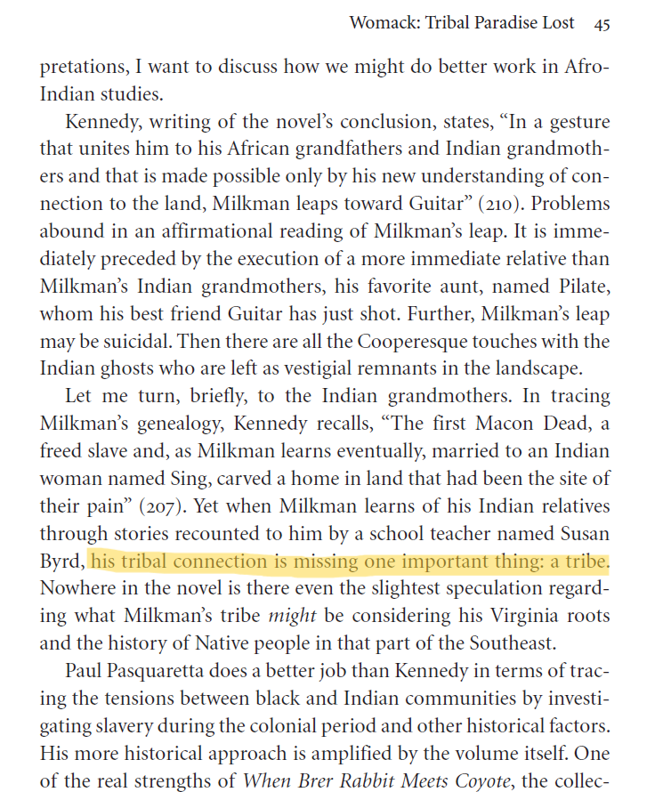
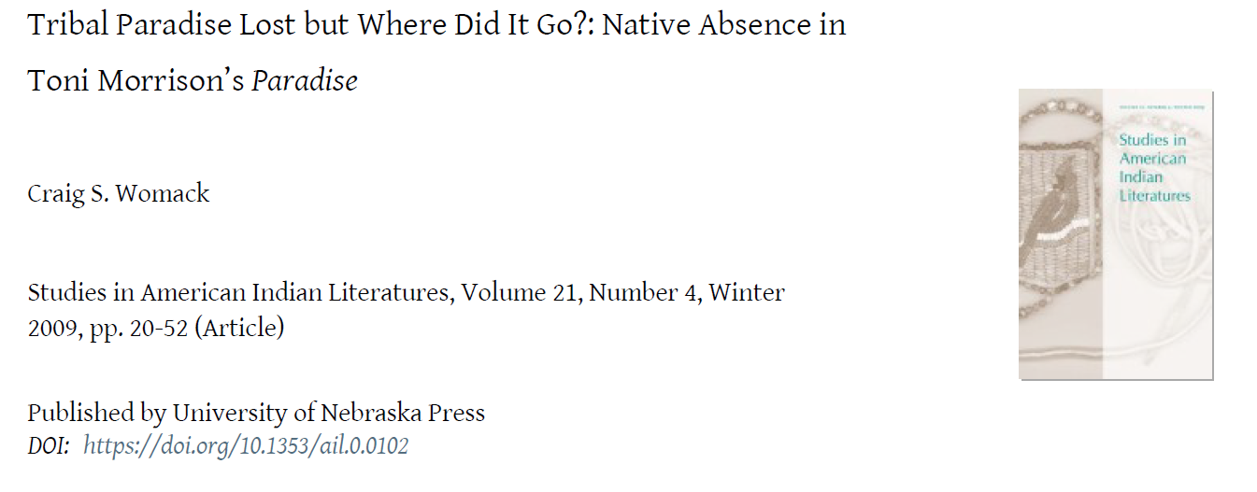
“Milkman’s tribal connection is missing one important thing: a tribe.”

Slide 12
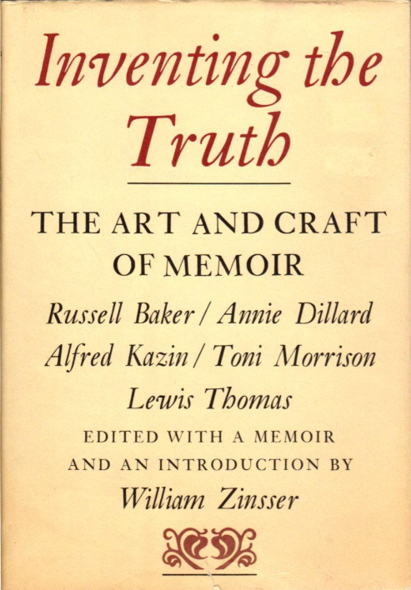
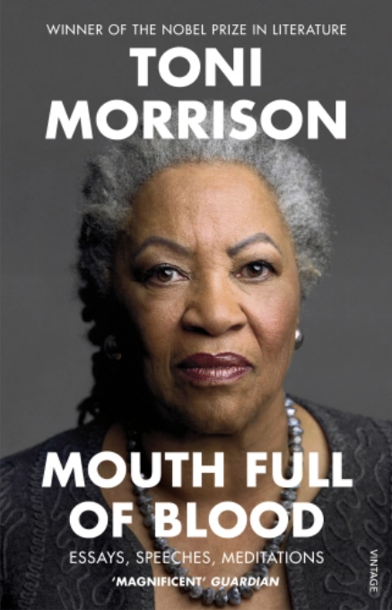
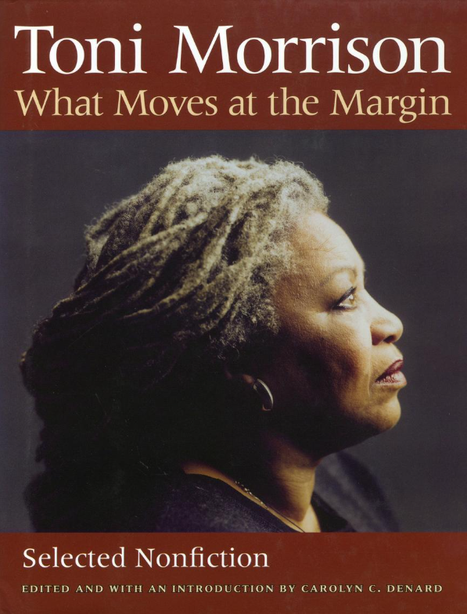
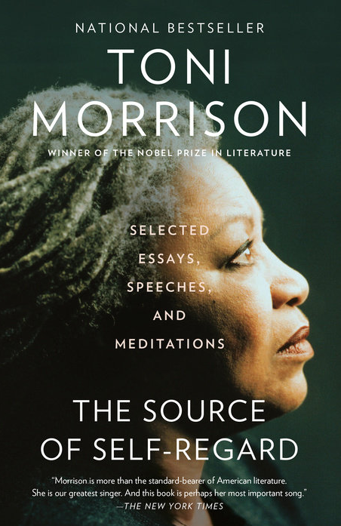
“The Site of Memory” (1987)
written for
1987
“literary archeology: on the basis of some information and a little bit of guesswork you journey to a site to see what remains were left behind and to reconstruct the world that these remains imply.” Morrison’s “deadly serious fidelity to the milieu out of which I write and in which my ancestors actually lived” means that “If I’m looking to find and expose a truth about the interior life of people who didn’t write it […] to fill in the blanks the slave narratives left […] to implement the stories that I heard, then the approach that’s the […] most trustworthy is the recollection that moves from the image to the text.”
collected in

Slide 13
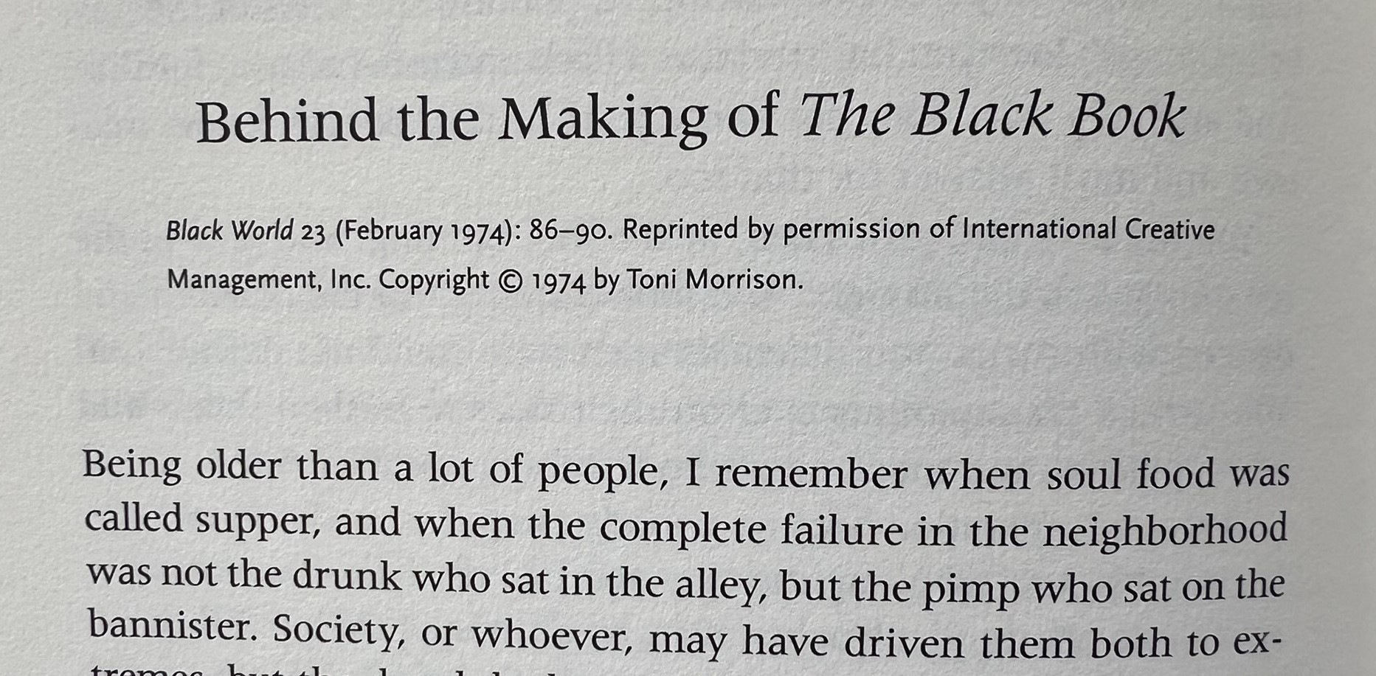
“To deliberately create a myth is a contradiction in terms. A myth is whatever concept of truth or reality a whole people has arrived at over years of observation.”
from collected in

Slide 14
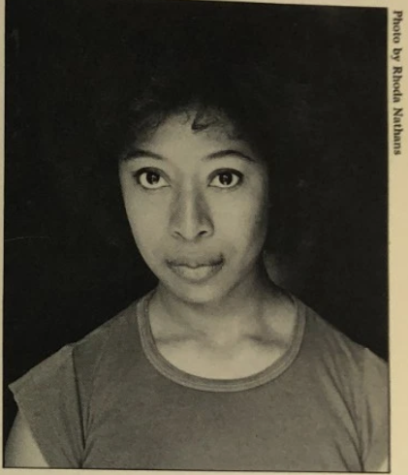
1976

Slide 15
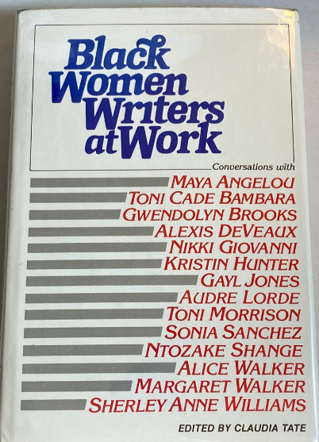
“Sometimes I have something like visitations, and I know they come from what is Indian in me, and I don’t necessarily mean Indian blood because I’m not getting back to that; you know my grandmother was such-and-such, although I’m sure the Cherokees were very thick with black folks in Georgia. […] In Georgia there are so many remnants of their presence that there is a real kinship with these people who were forced off the land that was theirs” (179).
1983

Slide 16
This is speculative ancestry: to write the certainties of history and the unknown specifics of ancestral relationships into each other.)

Slide 17
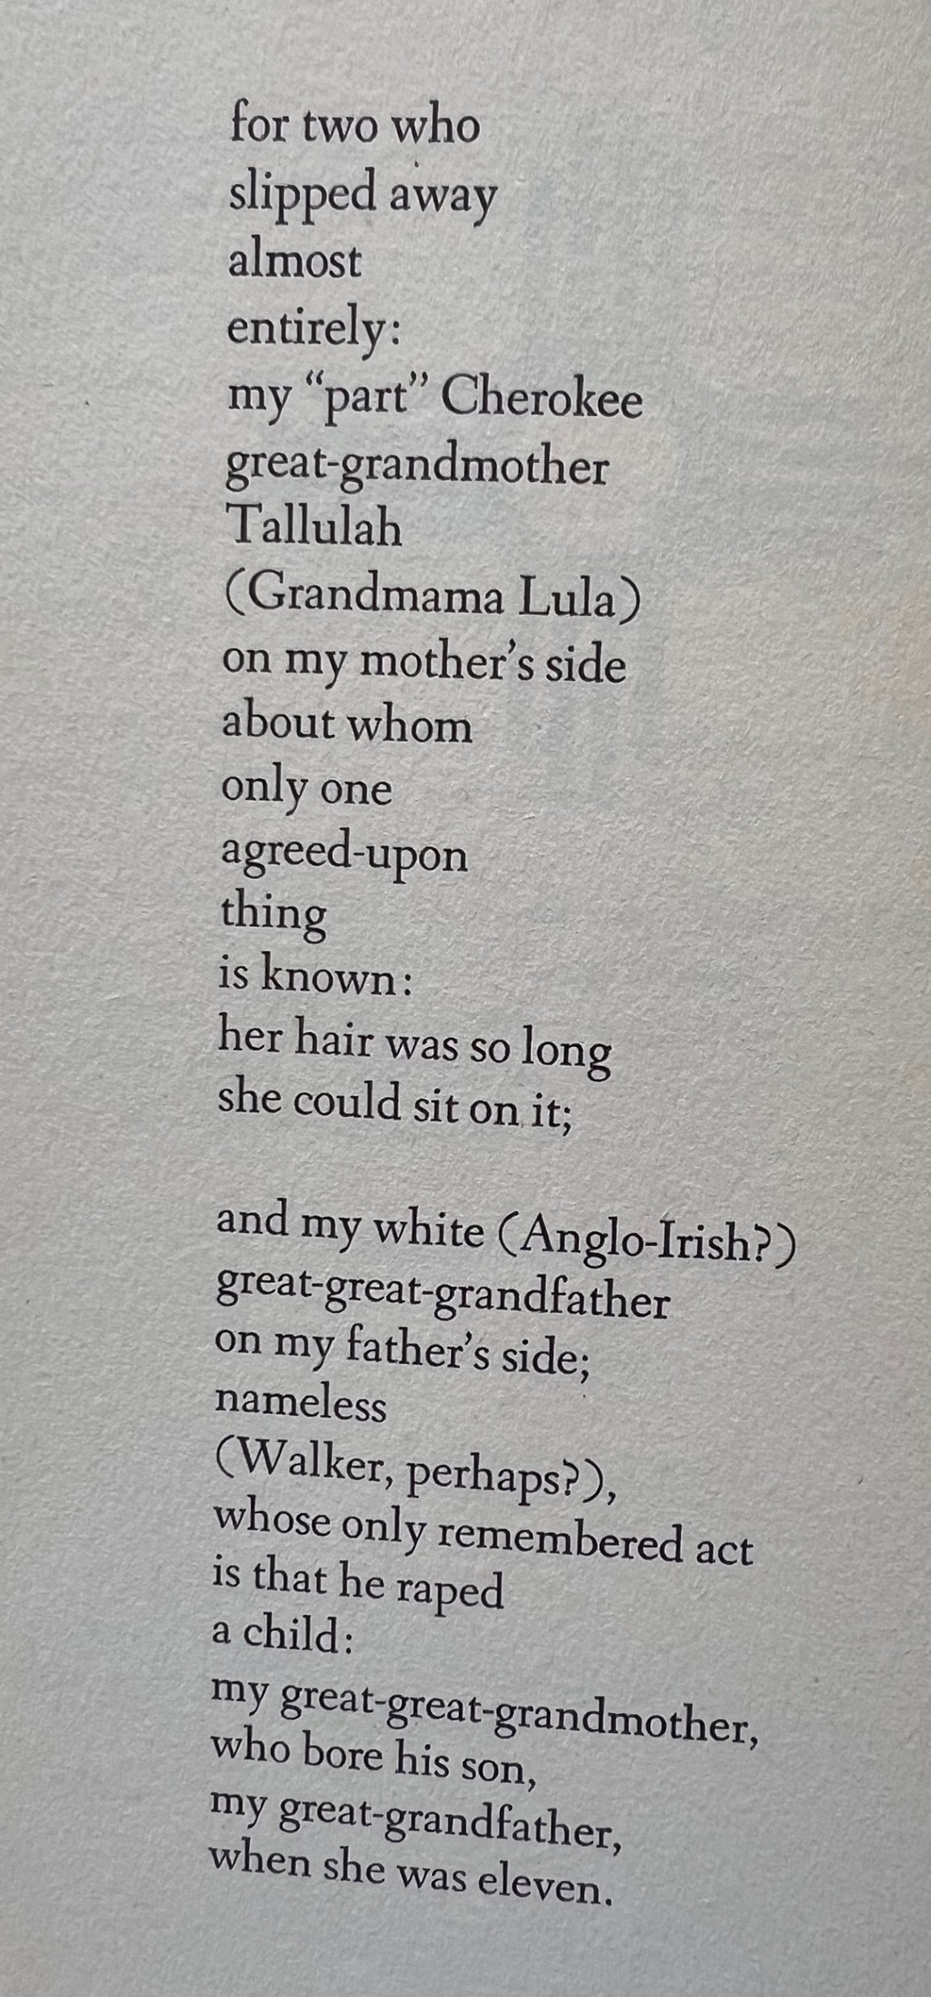
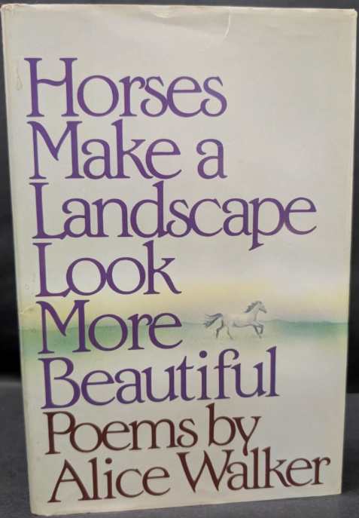
1984

Slide 18
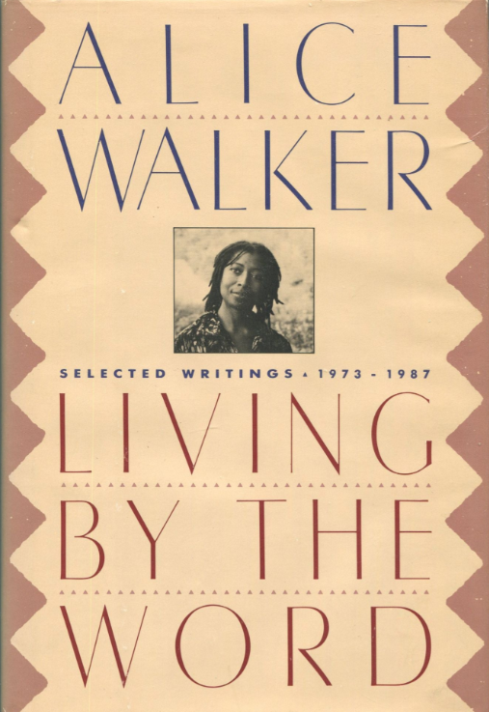
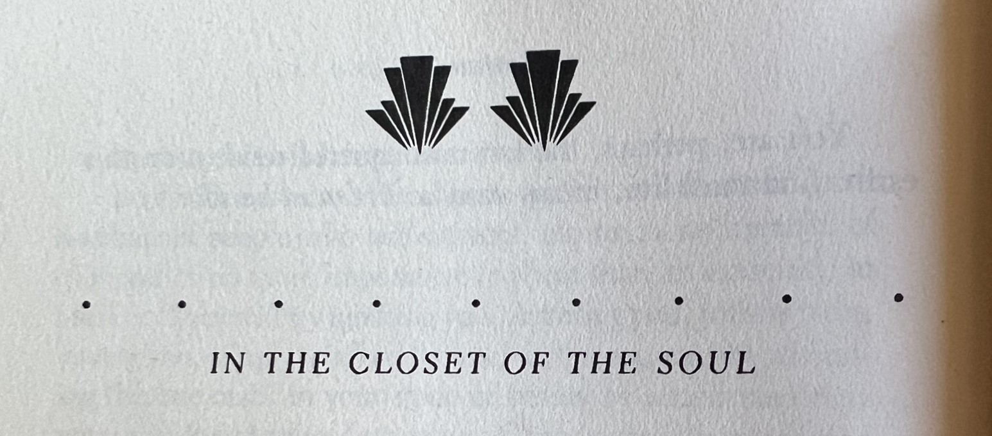
1987
I opened the heart of my soul, and there, with the Africans, are the Indian great-great-grandmother and the old white child molester and rapist (85). […] It is my blackness (not my skin color so much as the culture that nurtured me) that causes me to open myself, acknowledge my soul and its varied components, take risks, affirm everyone I can find (89).

Slide 19
“What were the myths, the functional values, Black people found useful for surviving enslavement and emancipation in the Americas?”
“What does it mean to have both the violent conflict of Black-white property relations and the sustaining alliances of Black-Native relations together as one’s bodily inheritance?”

Slide 20
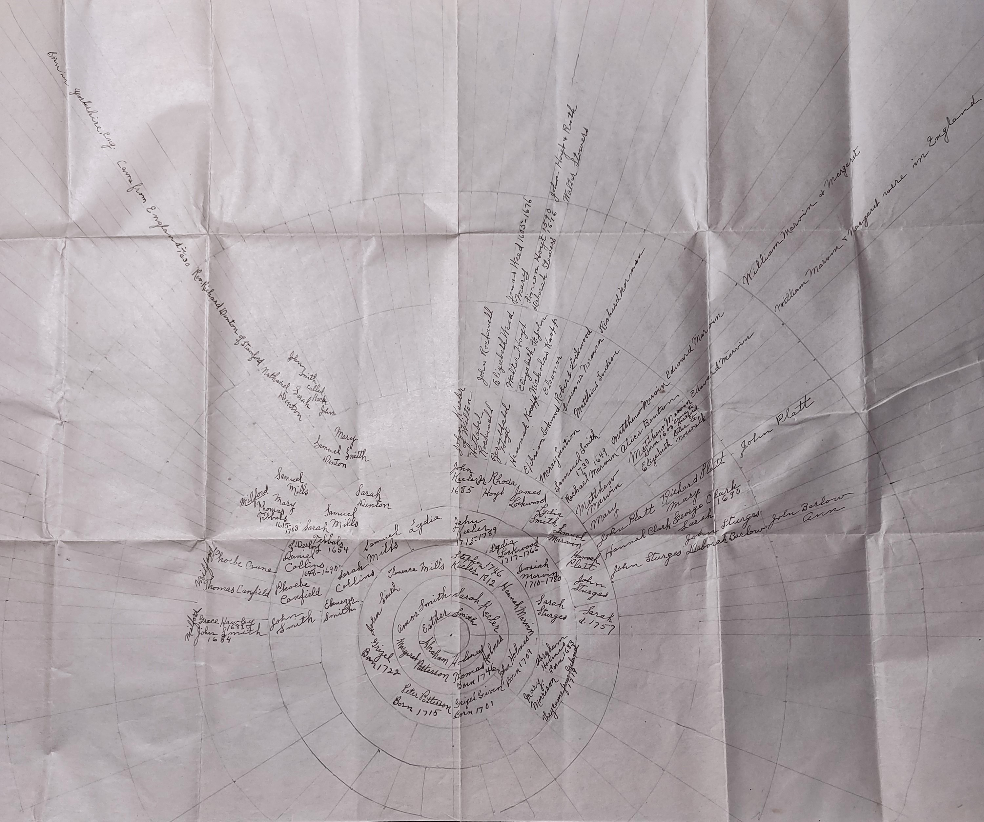
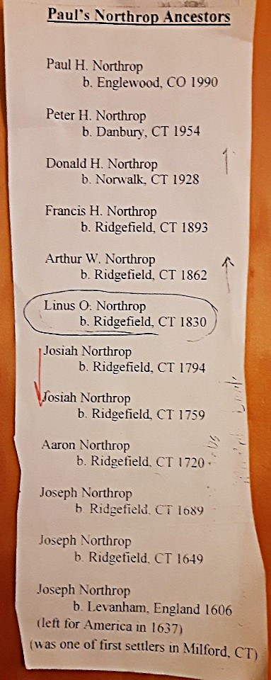
ancestral surroundings
vs. linear “descent”

Slide 21
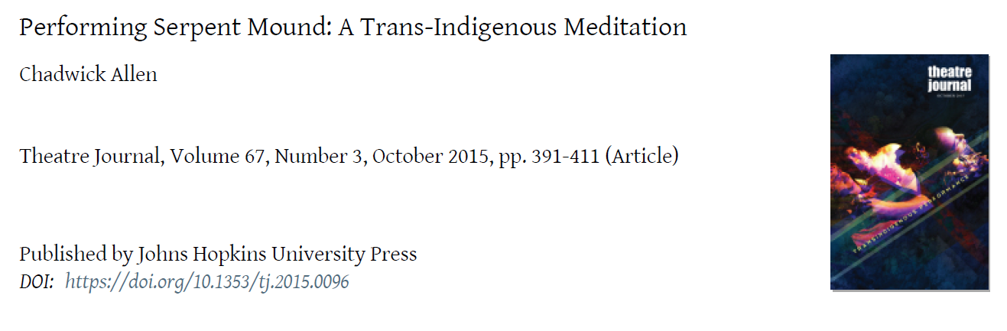

Slide 22
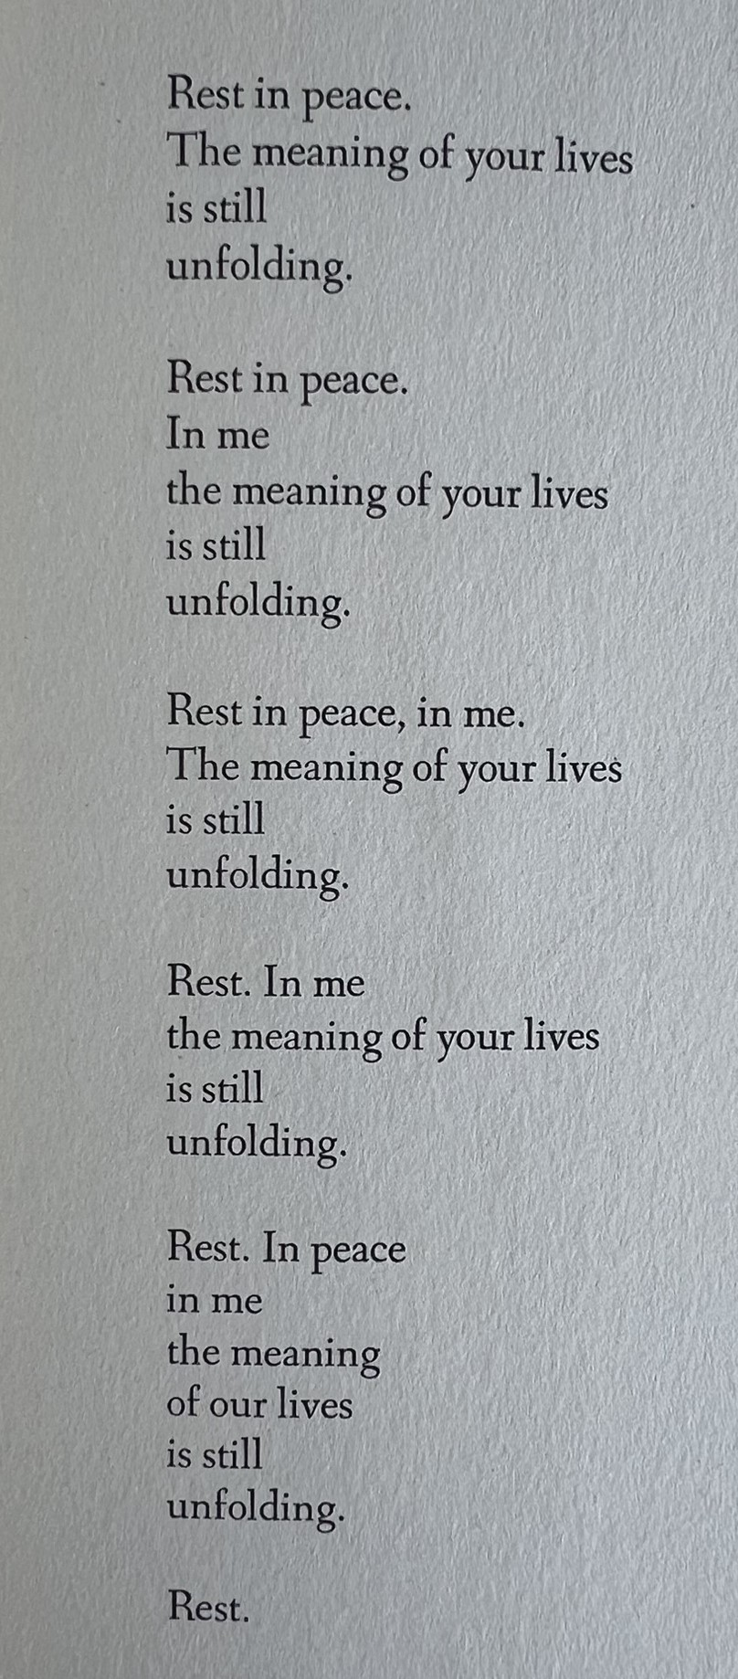
1984

Slide 23
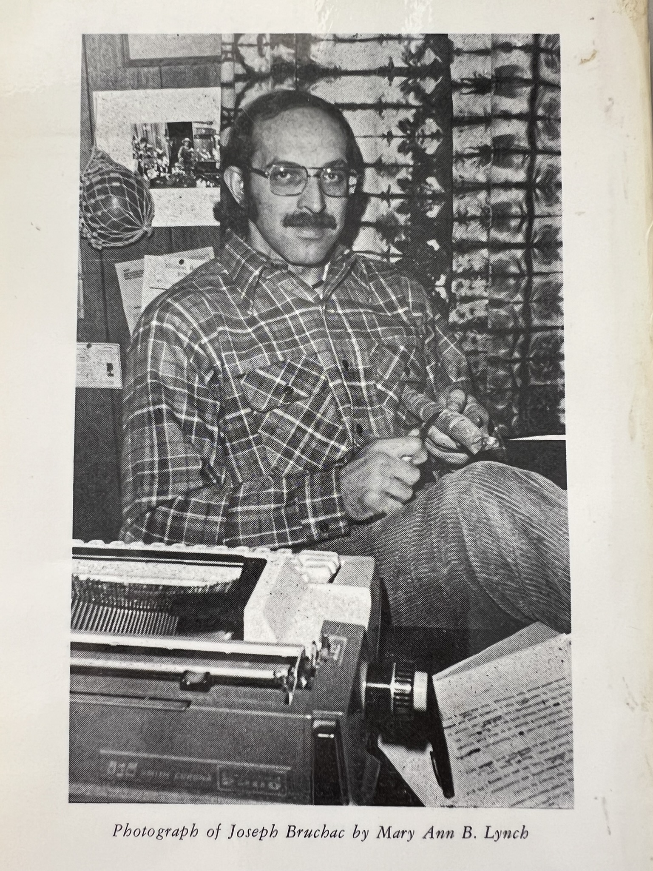
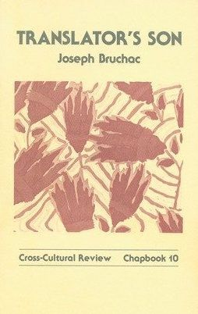

Slide 24
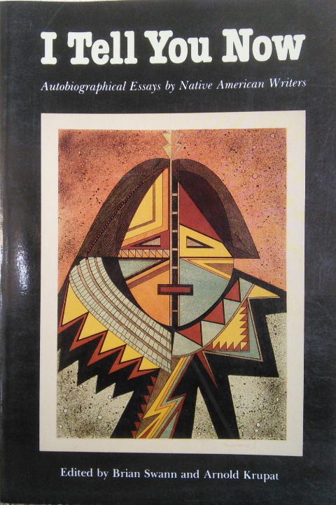
Had I been raised on other soil by other people, my Indian ancestry might have been less important, less shaping. But I was not raised in Czechoslovakia or England. I was raised in the foothills of the Adirondack Mountains near a town whose spring waters were regarded as sacred and healing by the Iroquois and Abenaki alike. (203)
1987

Slide 25
“What if the place-relating lifeways I most want to learn are already there in my own family but have been hidden or suppressed?”
See “Disputed Abenaki Belonging in Vermont and Canada” bibliography/chronology at rachelnorthrop.com > MELUS tab

Slide 26
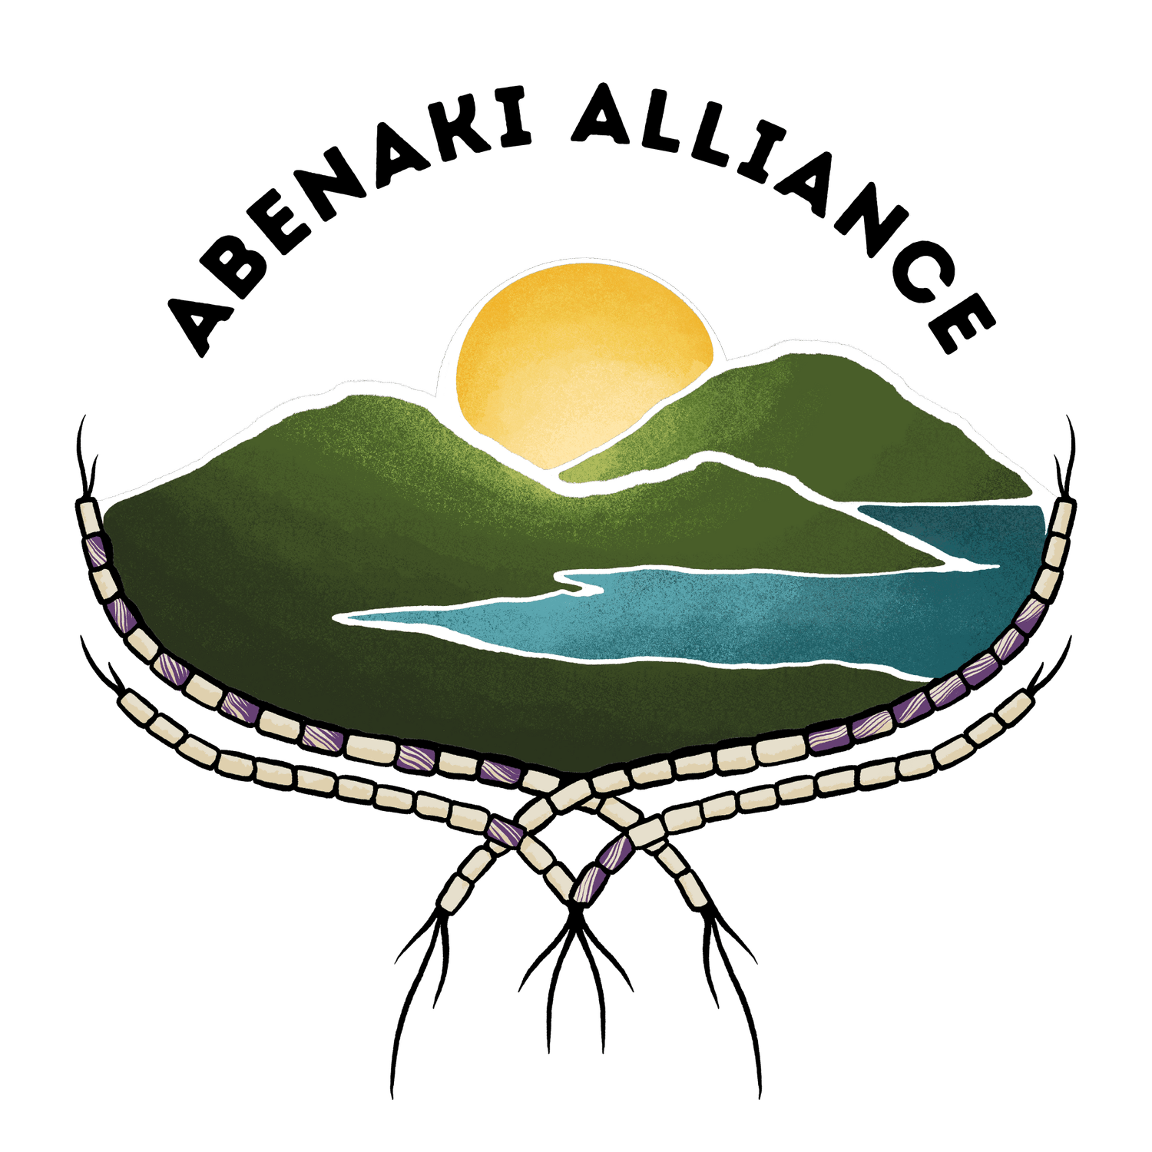
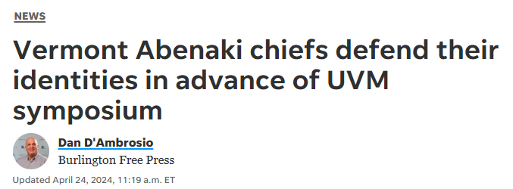
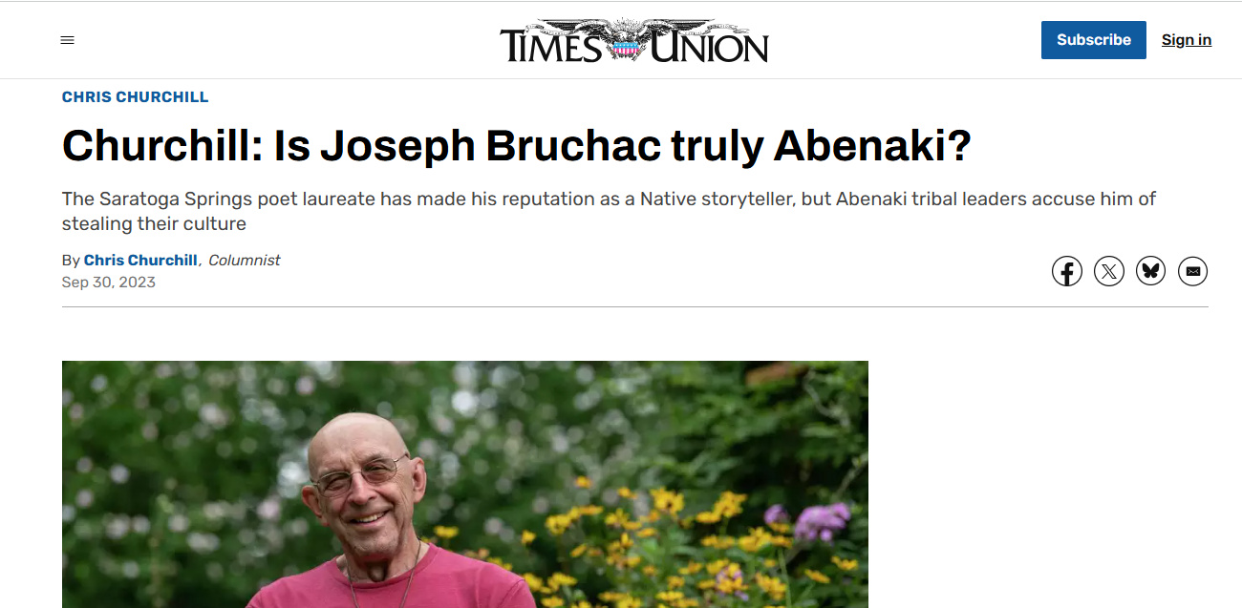

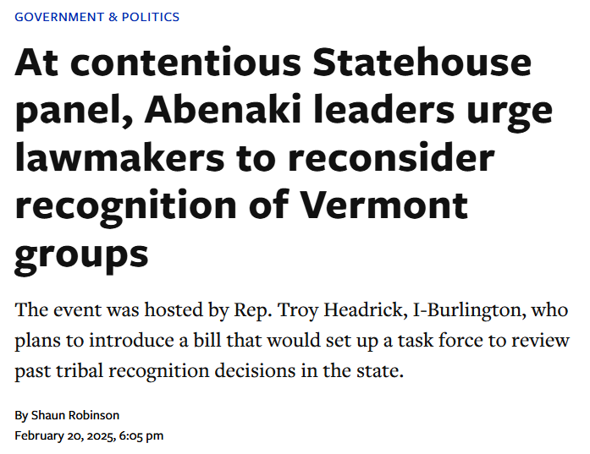
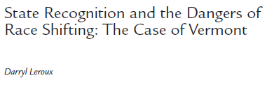
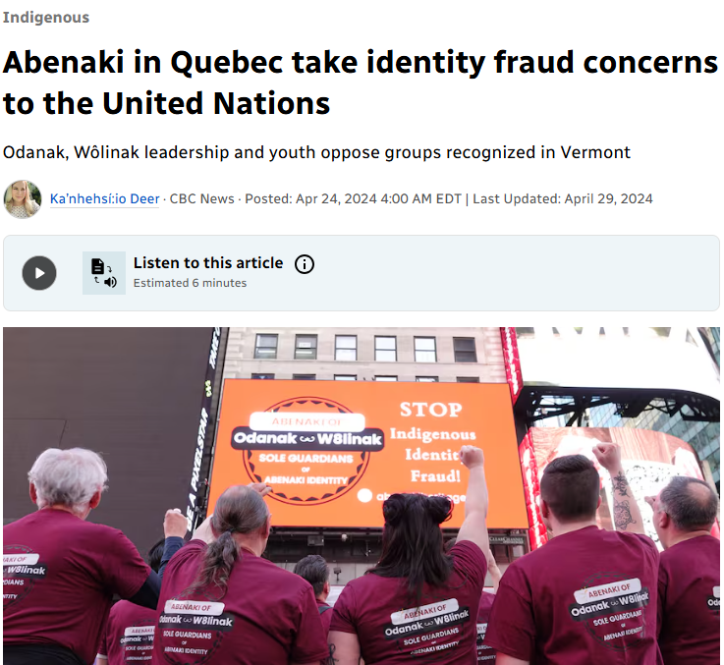
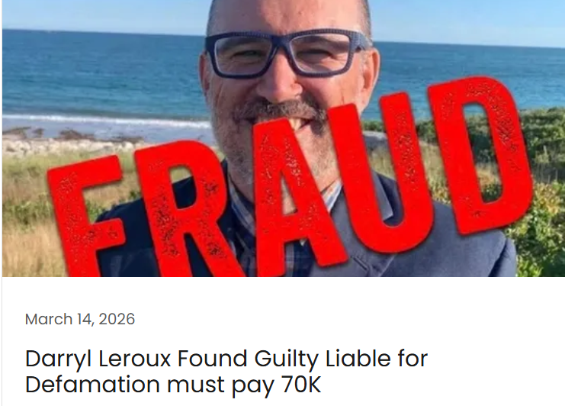
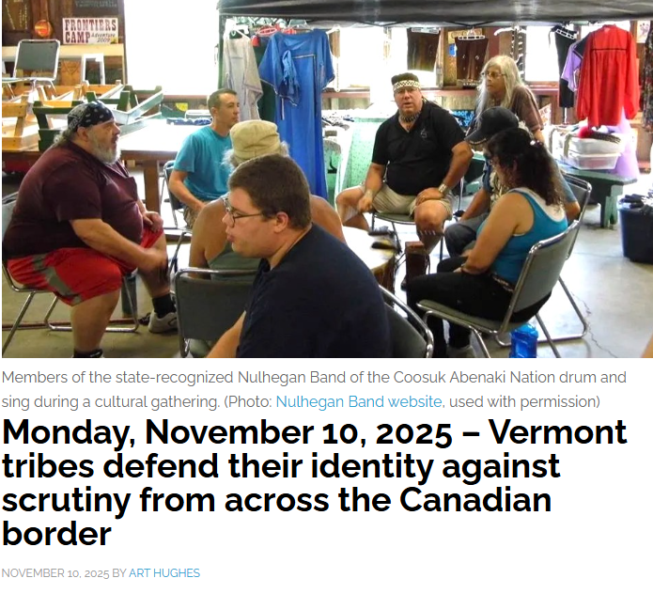
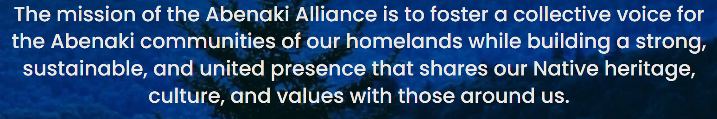
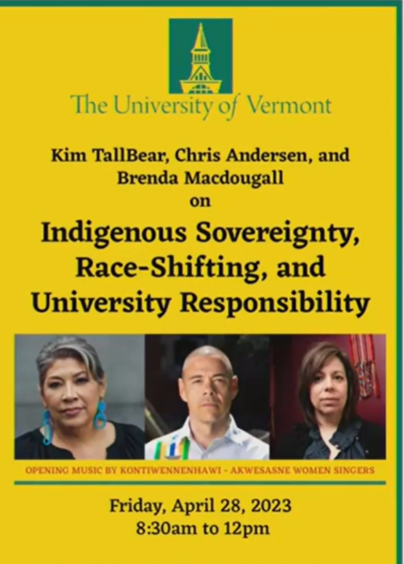
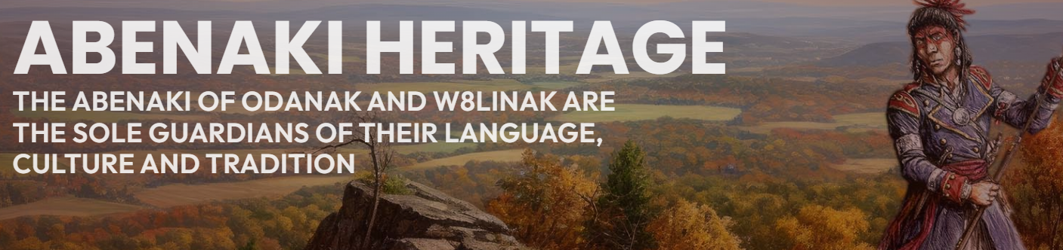

Slide 27
“How do mixed-race people in the Americas (which is to say, most people in the Americas) reconcile the tensions between the violent conflict of Black-white property relations and the sustaining alliances of Black-Native relations?”
“How did Black people survive enslavement and emancipation in the Americas? What were the tools, the myths and functional values, that sustained Black Americans through those trials?”
“How do I relate to the place that raised me in a way that honors both the grandfather who raised me and the place’s original inhabitants, especially if they are one and the same?”

Slide 28
1970s “bicentennial” literature doing speculative ancestry
1987 metaliterary essay describing speculative ancestry practice in retrospect

Slide 29
THANK YOU!
Rachel Northrop, PhD
northrop.rachel@gmail.com

